Slide 1

Visualizing machine learning

Slide 2
Avoid
Notes:
painful to look at- painful to use

Slide 3
Very high dimensionality!
Notes:
say we feed in a 20x20 image into a 3 layer neural network!

Slide 4
Active area of research
New algorithms and tools
being created

Slide 5
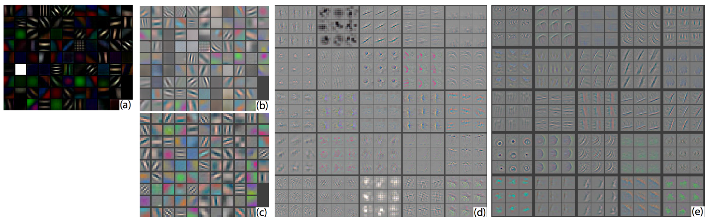
https://arxiv.org/pdf/1311.2901.pdf
Notes:
Visualizing and Understanding Convolutional Networks, Zeiler and Fergus

Slide 6
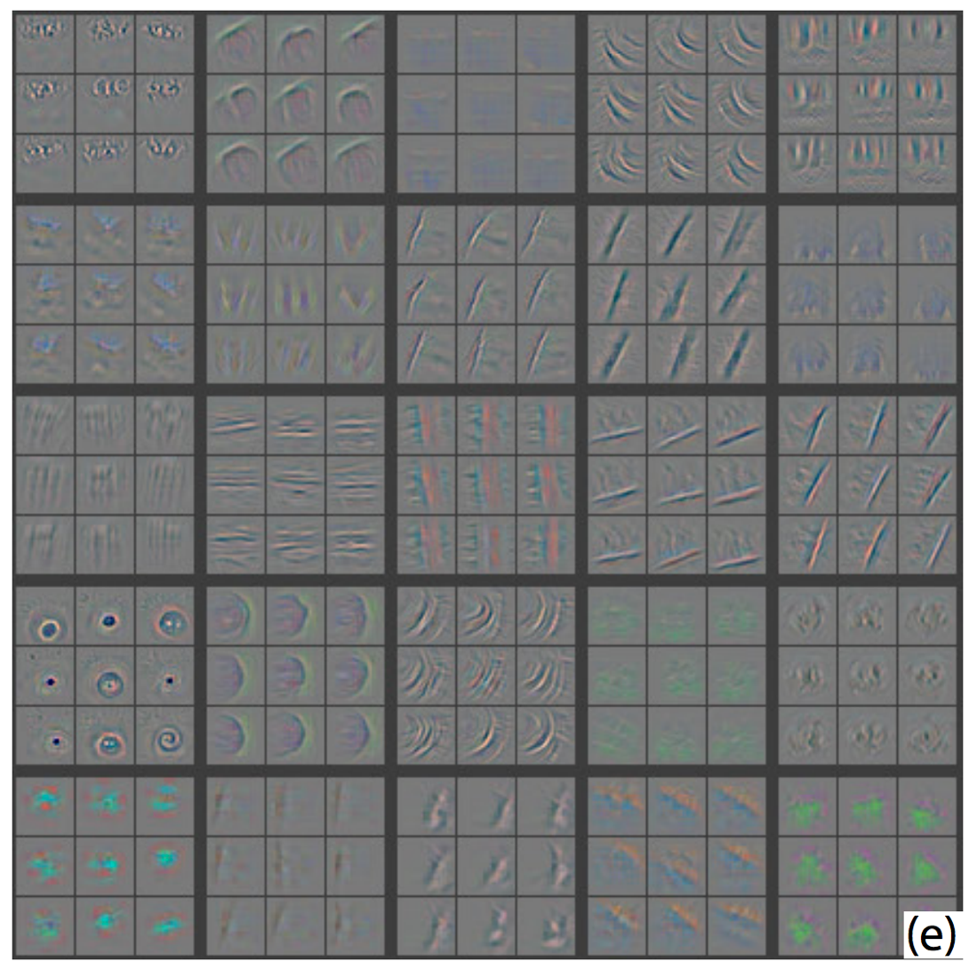
https://arxiv.org/pdf/1311.2901.pdf

Slide 7
MNIST dataset
Notes:
well known in computer vision
we train a classifier with a convolutional neural network
feed the first layer of the network into a visualization…

Slide 8
https://lvdmaaten.github.io/tsne/
Notes:
Woah!

Slide 9
Notes:
Woah!

Slide 10


